Slide 1

ENHANCING SPEECH IN REAL-TIME: USING DENSE NEURAL NETWORKS WITH DILATED CONVOLUTIONS AND SQUEEZED TEMPORAL CONVOLUTIONAL MODULES IN THE TIME DOMAIN.
Senior Design Project
WINTER SEM 2022-23
REVIEW 2
by
Bhumika E, 19bec7146
Guided by
Dr. Sunny Dayal Vanambathina

Slide 2
Agenda
Recap
Methodology
Existing model architecture
Proposed model architecture
Results
Progress & Future work
Timeline
References

Slide 3
Recap of review-1
In real-world situations, speech signals reaching our ears are usually degraded by the background noises like traffic and street noises.
These noises are detrimental to the speech quality and intelligibility, also cause a serious problem to many speech-related applications, such as automatic speech recognition and speaker identification.
The noise signals overlap and mask the useful speech signals.
To deal with overlapping background noise, a speech enhancement strategy is essential in order to make noisy speech more understandable.
The supervised and unsupervised approaches to speech enhancement generally convert the speech signal to a time-frequency (T-F) representation

Slide 4
Recap of review-1
The project aims to improve the quality of speech signals in real-time by removing noise and other disturbances from the audio signal.
The proposed method combines the strengths of dilated convolutions and dense neural networks (DNNs).
DNNs are used to extract features from the input signal.
The resulting output is a clean speech signal that is of higher quality than the input signal.

Slide 5
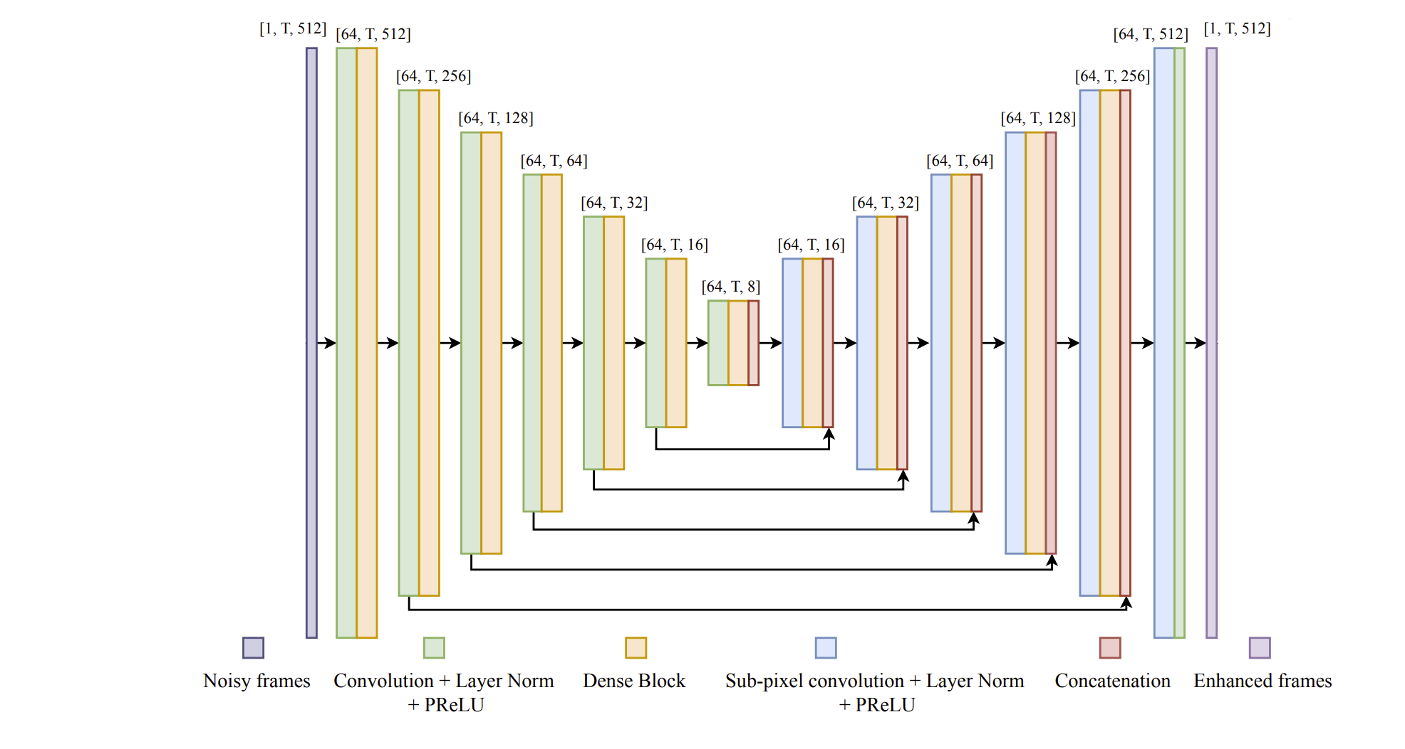
Methodology:
Existing model architecture

Slide 6
The existing model architecture
The model consists of an input layer, an encoder, dilated and dense blocks, a decoder, and an output layer.
Each layer in the encoder first halves the dimension using Max pooling (down sampling).
The decoder uses sub-pixel convolutions (up sampling) and dense blocks to successively reconstruct the signal to the original size.
The input to each layer in the decoder is a concatenation of the previous layer output and the output from the corresponding symmetric layer in the encoder in order to maintain the same dimension.

Slide 7
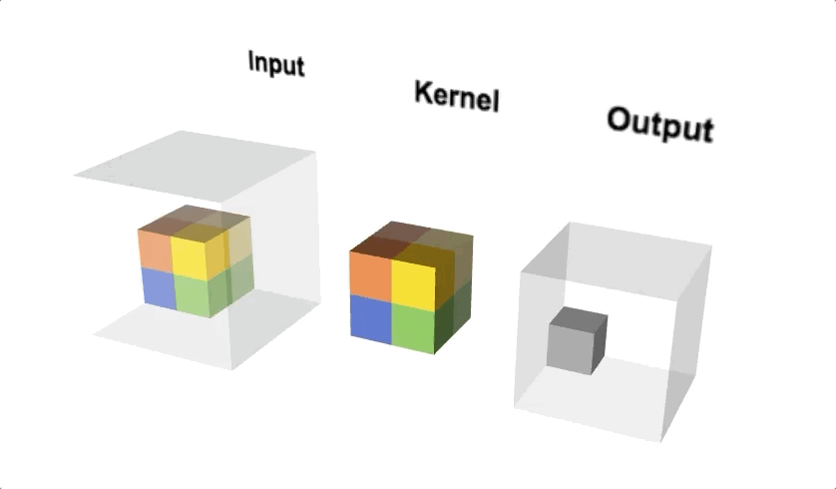
Convolutions
Convolution is the element-wise multiplication and addition.
We also have a kernel, which is simply a small matrix of weights.
This kernel “slides” over the input data, performing an elementwise multiplication with the part of the input it is currently on.
And then summing up the results into a single output pixel.
The purpose of doing convolution is to extract useful features from the input.

Slide 8
Parametric Rectified Linear Unit (PReLU) and
Layer Normalization
PReLU is an advanced activation function that can be used in dense neural networks to improve the efficiency of speech enhancement algorithms.
PReLU introduces a learnable parameter that controls the slope of the negative part of the activation function, allowing for greater flexibility and accuracy in the network's predictions.
Layer normalization is another technique that can be used to improve the performance of real-time speech enhancement algorithms.
This technique normalizes the input to each layer of the network, reducing the impact of variations in the input signal and improving the stability of the network's output.

Slide 9
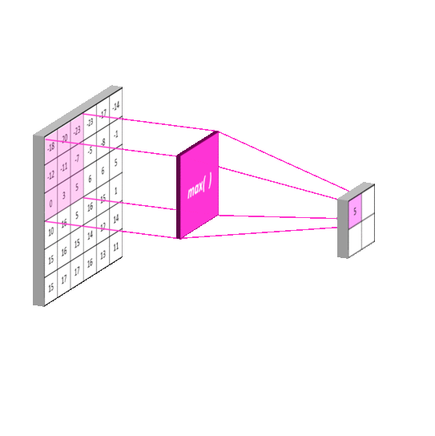
Max pooling
One of the down sampling methods, conducts dimensionality reduction, reducing the number of parameters in the input.
Similar to the convolutional layer, the max pooling operation sweeps a filter across the entire input, but the difference is that this filter does not have any weights.
The input is traversed by the filter, and the output array receives the pixel that has the maximum value among the selected ones.

Slide 10
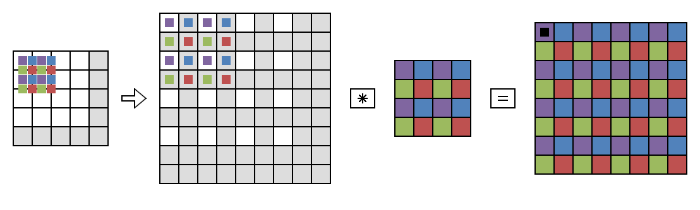
Sub-pixel Convolutions
Subpixel convolutions are a type of convolutional layer that can be used to increase the resolution of an image or signal(up sampling).
In the context of speech enhancement, subpixel convolutions can be used to improve the quality of the output signal by increasing the sampling rate.
The decoder uses sub-pixel convolutions and dense block to successively reconstruct the signal to the original size.

Slide 11
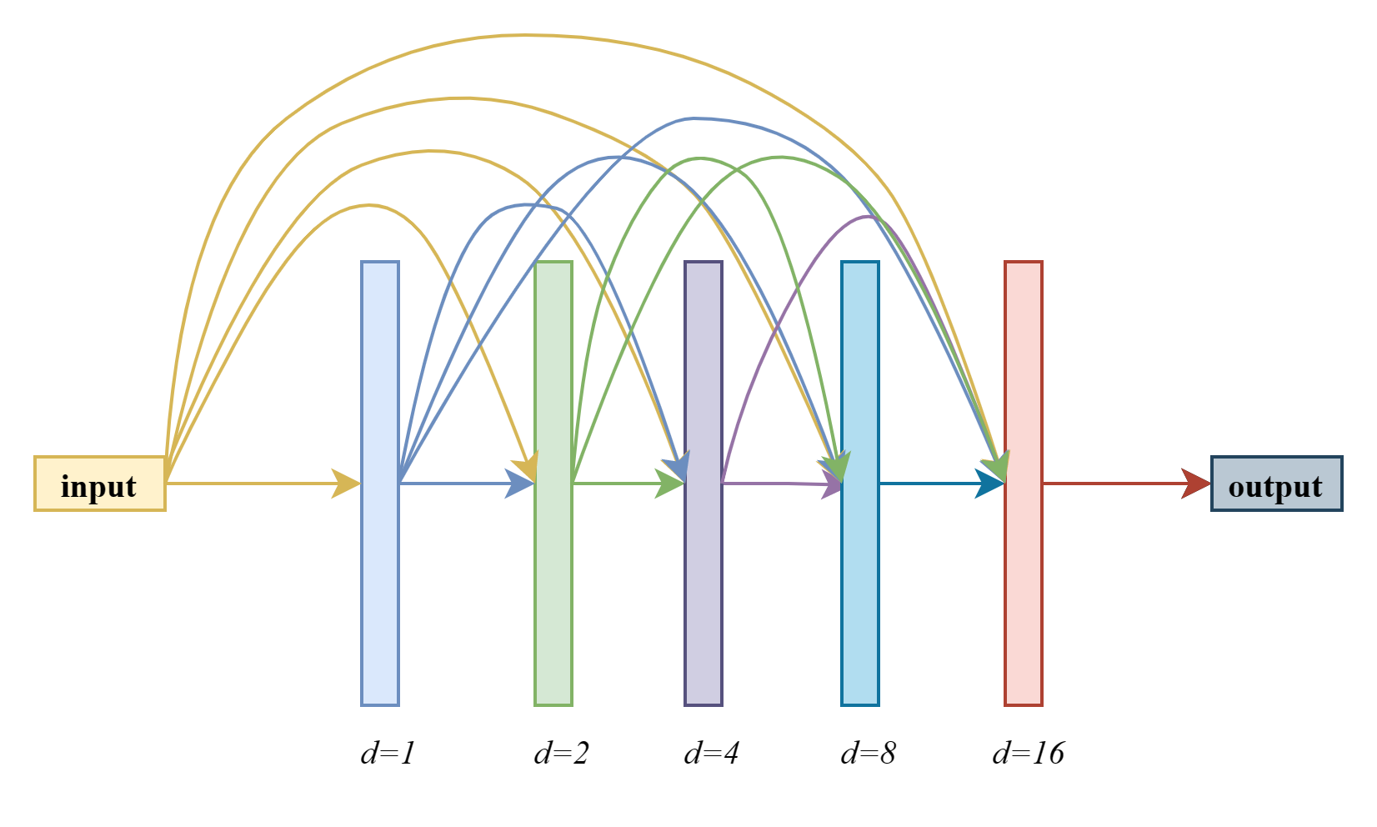
Dilated Dense Networks (DDNs)
The dilated convolutional layer allows the network to process information at different scales, making it more robust to variations in speech patterns.
This allows the network to capture long-term dependencies in the speech signal.
In DDN, the final output layer has direct information from every single layer including the very first layer.
This kind of network helps in feature-reuse and better transmission of features across the network.

Slide 12
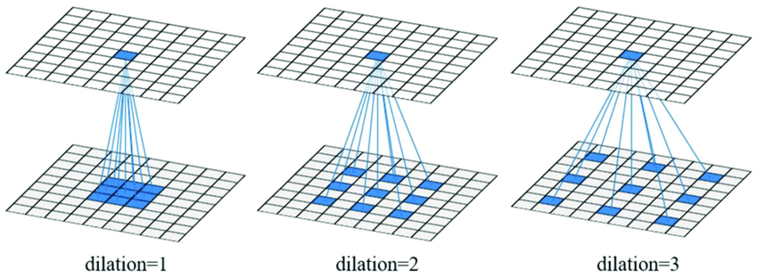
Each layer undergoes dilated convolutions with dilation rate d= 1, 2, 4, 8, 16..
The dense neural network is responsible for extracting features from the noisy speech signal.
These features are then passed onto the squeezed temporal convolutional network which applies temporal convolutions to extract relevant information.

Slide 13
The proposed model architecture
The proposed model includes squeezed temporal convolutional networks and GRU layers to enhance the accuracy and speed of speech recognition systems.
These layers work together to reduce errors caused by variations in speech patterns and enhance the overall quality of the output signal.

Slide 14
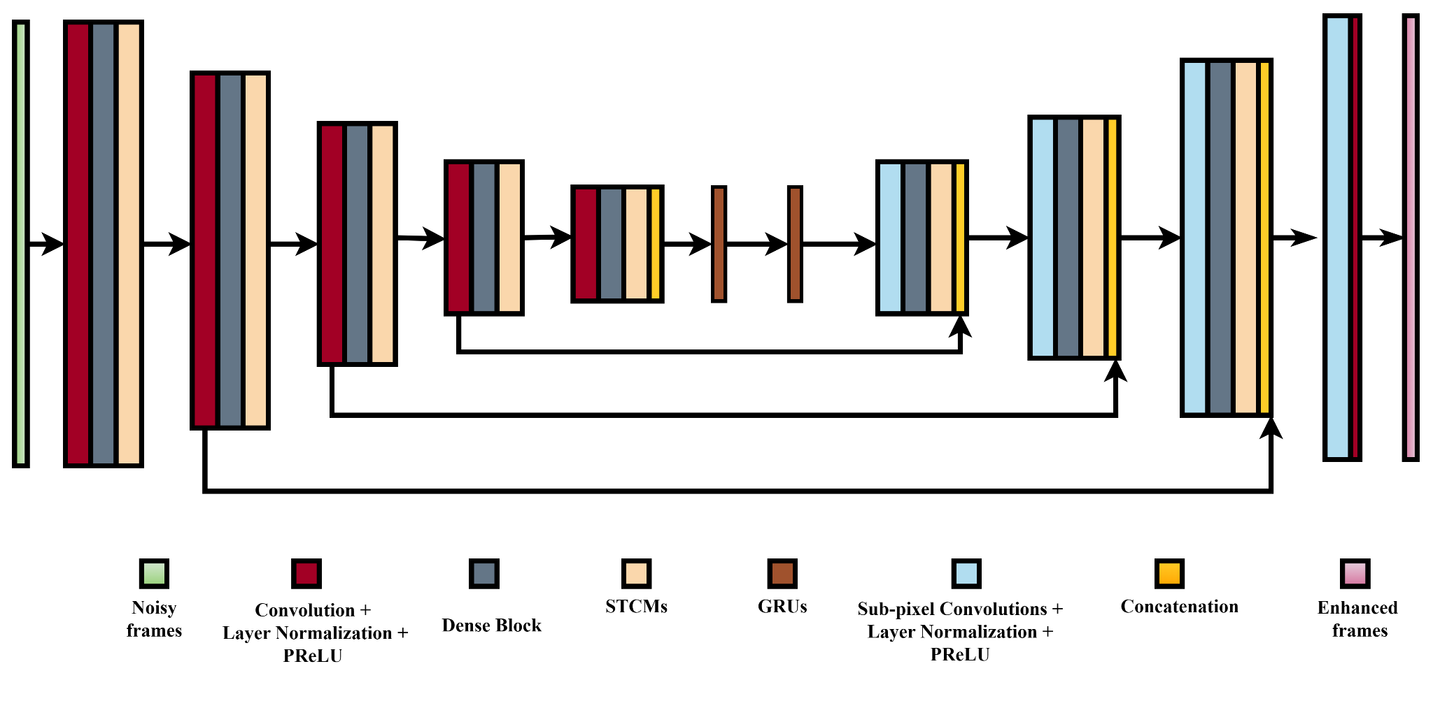
Proposed model architecture

Slide 15
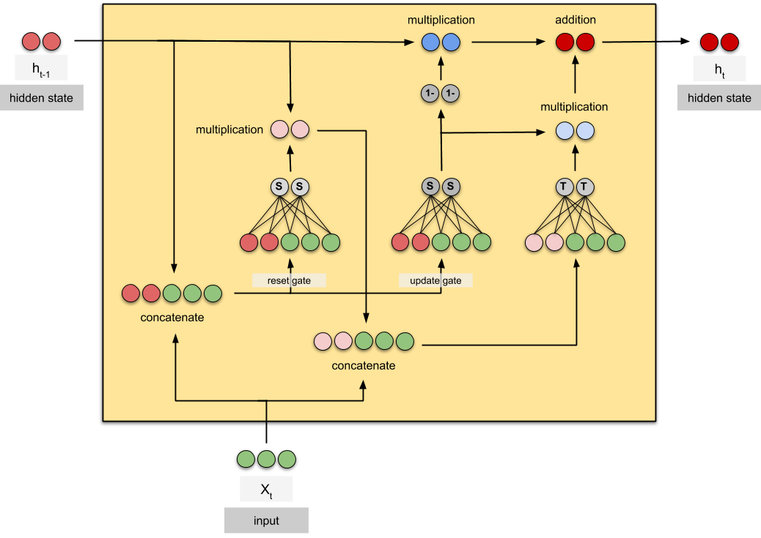
Gated Recurrent Units (GRUs)
GRUs can be used to enhance speech signals in real-time.
GRUs use gating mechanisms to control the flow of information through the network, allowing it to selectively remember or forget previous inputs.
They are update gate and reset gate.
The update gate helps to determine how much of the past information needs to be passed along to the future.
The reset gate is used to decide how much of the past information to forget.
GRUs provide a trained model with consistent memory capable of seizing short-term and long-term dependencies among speech frames effectively.

Slide 16
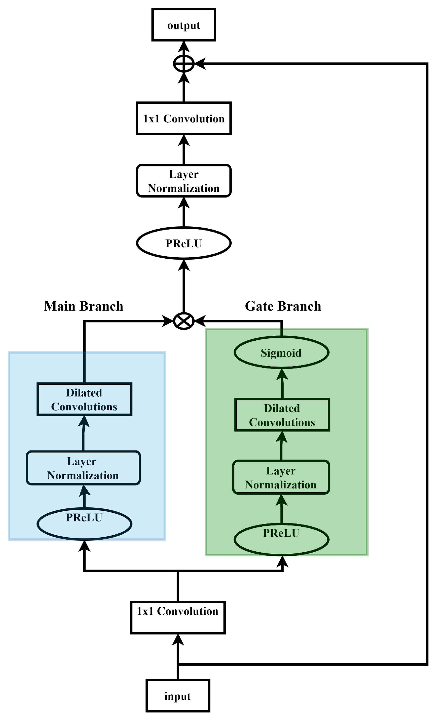
Squeezed Temporal Convolutional Modules (STCMs)
STCMs are one of the deep learning architectures that can enhance speech signals in real-time.
STCMs use a combination of 1D and 2D dilated convolutions to extract both temporal and spectral features from the input signal.
They work by compressing the temporal dimension of the input signal before applying convolutional filters, which reduces the number of computations required and speeds up processing time.
This makes them ideal for use in real-time applications where low latency is critical.
The use of STCMs can enhance speech to even greater levels, allowing for clear communication in extremely noisy environments.

Slide 17
Results
Table 1: model comparison in terms of STOI in presence of babble noise and restaurant noise
Test noise | Babble |  |  |  |  |  | Restaurant
Models | Input SNR
 | -5dB | -2dB | 0dB | 2dB | 5dB | Average | -5dB | -2dB | 0dB | 2dB | 5dB | Average
Mixture | 57.21 | 64.42 | 68.96 | 73.12 | 80.29 | 69.00 | 56.23 | 63.12 | 68.21 | 72.14 | 78.92 | 67.72
CRN[1] | 79.32 | 84.36 | 87.93 | 90.24 | 91.98 | 86.58 | 76.39 | 83.73 | 87.23 | 88.47 | 91.02 | 85.36
AECNN-SM[2] | 79.45 | 86.93 | 89.34 | 91.23 | 93.25 | 88.05 | 77.93 | 86.04 | 88.19 | 90.29 | 92.65 | 87.02
TCNN[3] | 81.32 | 86.57 | 89.43 | 91.57 | 93.26 | 88.44 | 78.94 | 86.04 | 88.19 | 90.29 | 92.76 | 87.24
DDAEC[4] | 81.21 | 89.73 | 91.19 | 93.01 | 94.11 | 90.25 | 80.18 | 86.95 | 89.37 | 91.74 | 92.78 | 88.20
Proposed model | 84.14 | 90.52 | 92.67 | 94.32 | 95.78 | 91.48 | 82.19 | 99.79 | 91.76 | 93.56 | 95.99 | 90.45

Slide 18
Table 2: model comparison in terms of PESQ in presence of babble noise and restaurant noise
Test noise | Babble |  |  |  |  |  | Restaurant
Models | Input SNR
 | -5dB | -2dB | 0dB | 2dB | 5dB | Average | -5dB | -2dB | 0dB | 2dB | 5dB | Average
Mixture | 1.32 | 1.56 | 1.68 | 1.79 | 2.03 | 1.67 | 1.32 | 1.51 | 1.63 | 1.80 | 2.01 | 1.65
CRN[1] | 2.01 | 2.41 | 2.53 | 2.71 | 2.89 | 2.51 | 2.01 | 2.29 | 2.48 | 2.59 | 2.80 | 2.43
AECNN-SM[2] | 2.13 | 2.49 | 2.53 | 2.83 | 2.99 | 2.59 | 2.12 | 2.47 | 2.60 | 2.79 | 3.01 | 2.59
TCNN[3] | 2.08 | 2.39 | 2.58 | 2.78 | 2.95 | 2.49 | 2.02 | 2.29 | 2.49 | 2.68 | 2.85 | 2.46
DDAEC[4] | 2.19 | 2.59 | 2.80 | 2.96 | 3.18 | 2.74 | 2.25 | 2.57 | 2.76 | 2.91 | 3.12 | 2.72
Proposed model | 2.31 | 2.75 | 2.93 | 3.16 | 3.32 | 2.89 | 2.33 | 2.69 | 2.87 | 3.06 | 3.25 | 2.84

Slide 19

Table 3: noisy speech and enhanced speeches in presence of babble noise and restaurant noise
Test noise | Babble |  |  | Restaurant
Speech type | Input SNR
Speech type | -5dB | 0dB | 5dB | -5dB | 0dB | 5dB
Noisy speech
Enhanced speech

Slide 20
Progress & Future work
replicated an existing paper and extended it by incorporating GRU and STCM layers.
currently in the process of writing a new paper that presents my proposed work.
working on analyzing the results of my proposed approach communicating the published paper.
planning to communicate the findings of my published paper to the relevant audience.

Slide 21
Timeline
Feb-March
Results of the existing paper and Start proposed
paper
April-May
Understanding
the research paper and started coding
Communicating the proposed paper.
March-April

Slide 22
References
[1] K. Tan and D. Wang, “Complex spectral mapping with a convolutional recurrent network for monaural speech enhancement,” in ICASSP, 2019, pp. 6865–6869.
[2] A. Pandey and D. Wang “A new framework for cnn-based speech enhancement in the time domain,”IEEE/ACM Transactions on Audio, Speech and Language Processing (TASLP), vol. 27, no. 7, pp. 1179–1188, 2019
[3] A. Pandey and D. Wang, “TCNN: Temporal convolutional neural network for real-time speech enhancement in the time domain,” in ICASSP, 2019, pp. 6875–6879
[4] Ashutosh Pandey and DeLiang Wang, "Densely connected neural network with diluted convolution for real-time speech enhancement in the time domain", 2022, 6629-6631.
[4] Huang, Z. Liu, L. Van Der Maaten, and K. Q. Weinberger, “Densely connected convolutional networks,” in IEEE conference on computer vision and pattern recognition, 2017, 4700–4708.

Slide 23
THANK YOU!

